Slide 1
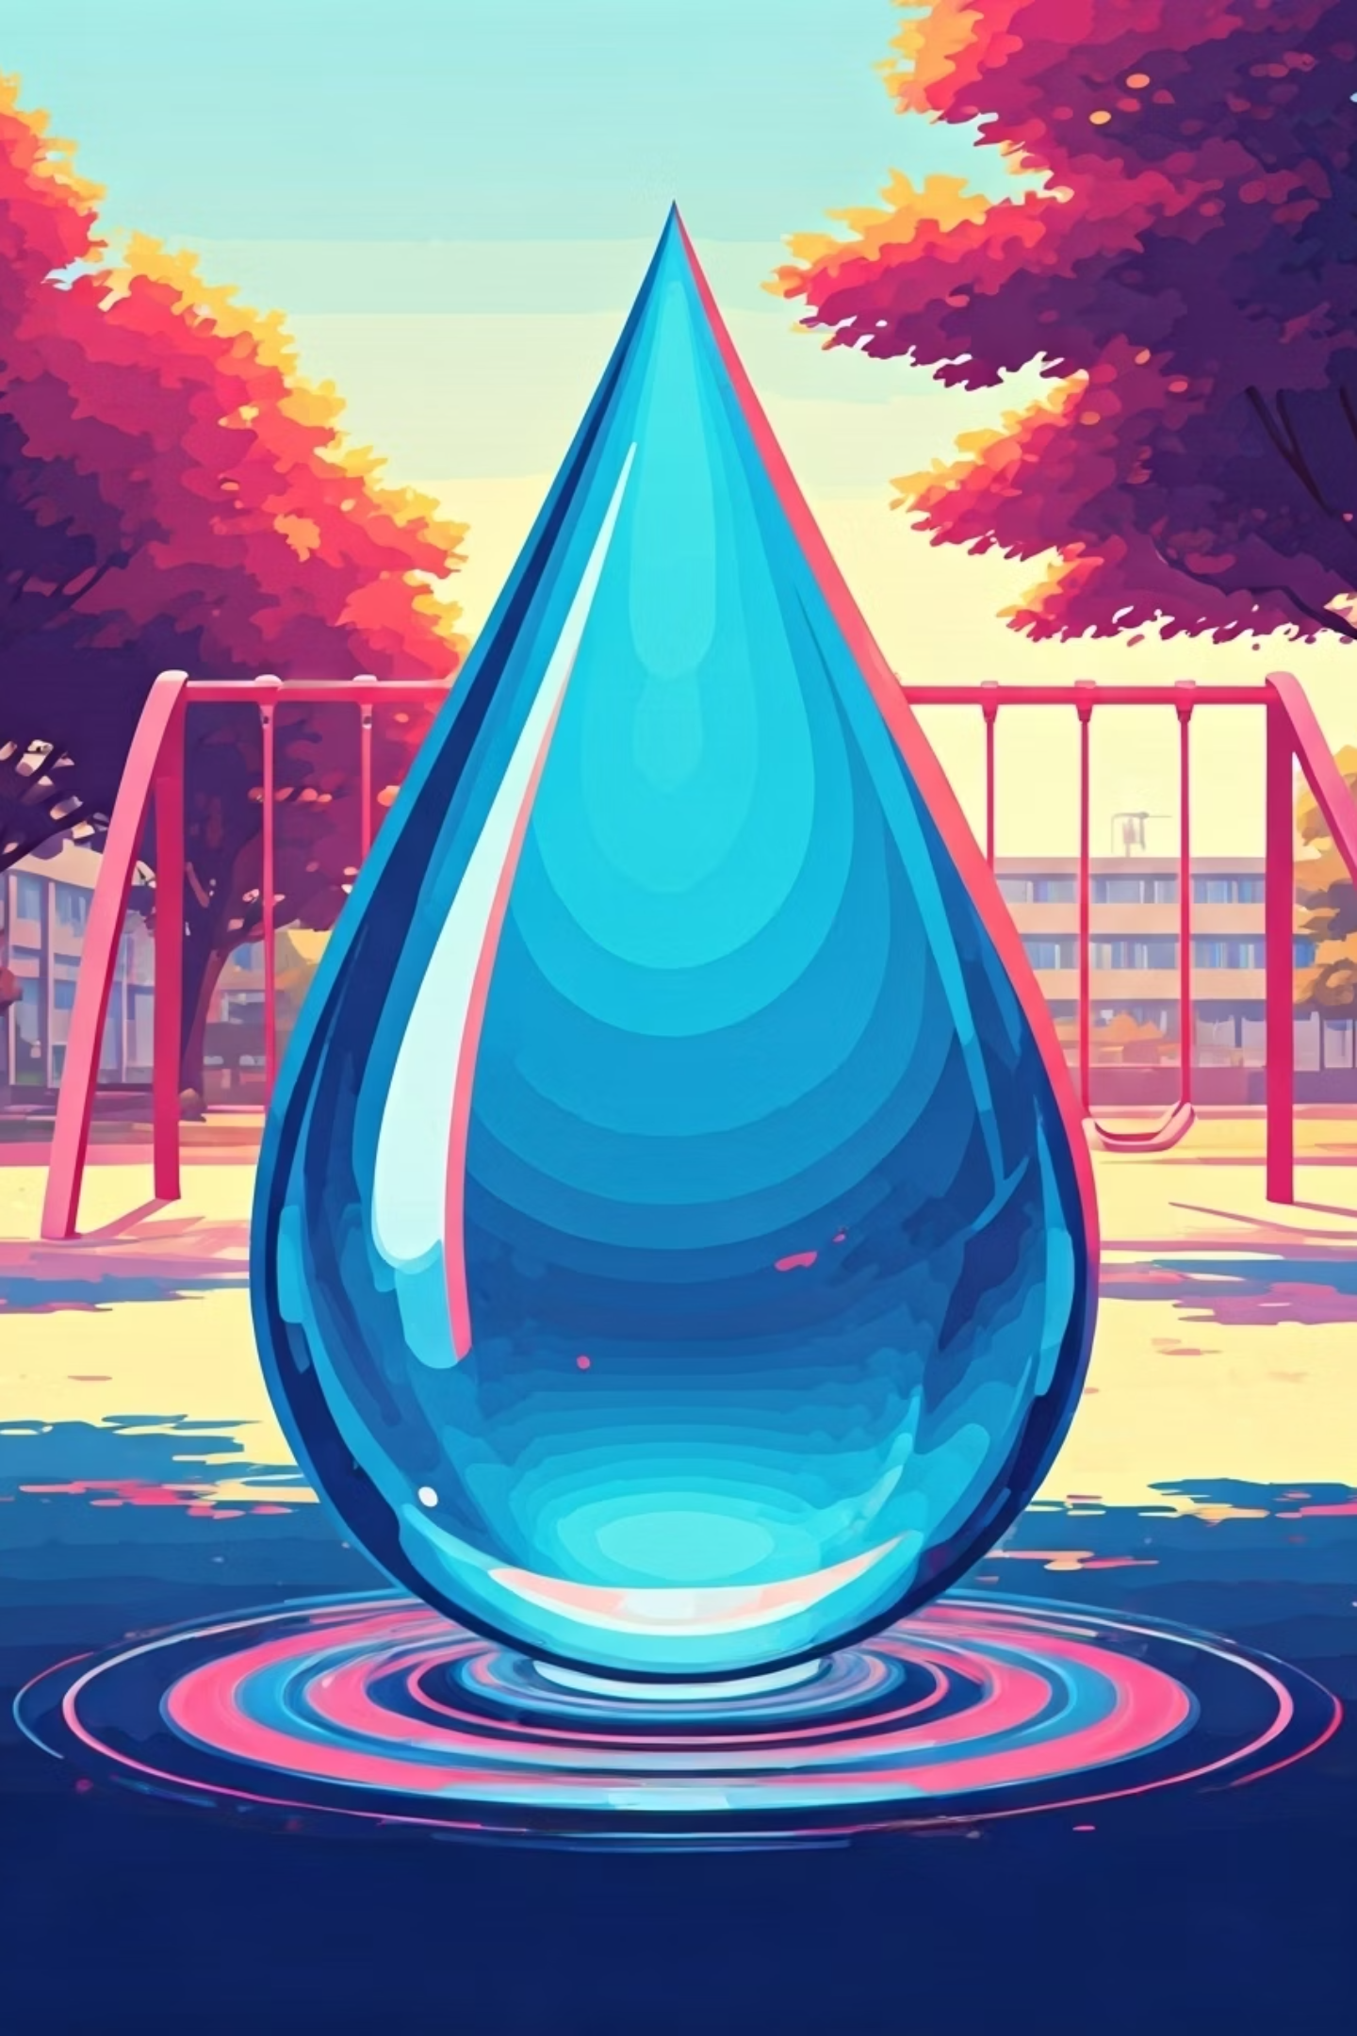
Community Service Project: Water Facilities and Drinking Water Availability
Department of ECE, SVCE, Tirupati

Slide 2
Team Members:
A. Harsha Vardhana Ganesh - 23BFA04013
B. Saravan Sai – 23BFA04038
A. Devi Sri Priya – 23BFA04028
B. Yamini - 23BFA04048
B. Sruthi – 23BFA04056
B. Himabindu - 23BFA04064
C. Pavan Kumar - 23BFA04066
B. Madhu Purushottam - 23BFA04041
A. Hiranmayee - 23BFA04005
B. Mounika - 23BFA04062
B. Venkata Dhanush Kumar - 23BFA04039
B. Sunil – 23BFA04042
A. Gayatri - 23BFA04014
A. Vandhana - 23BFA04030
A. Sujith - 23BFA04022
A. Leela Krishna – 23BFA04011
A. Hareesh - 24BFA04L02
B. Shiiva - 23BFA04060

Slide 3
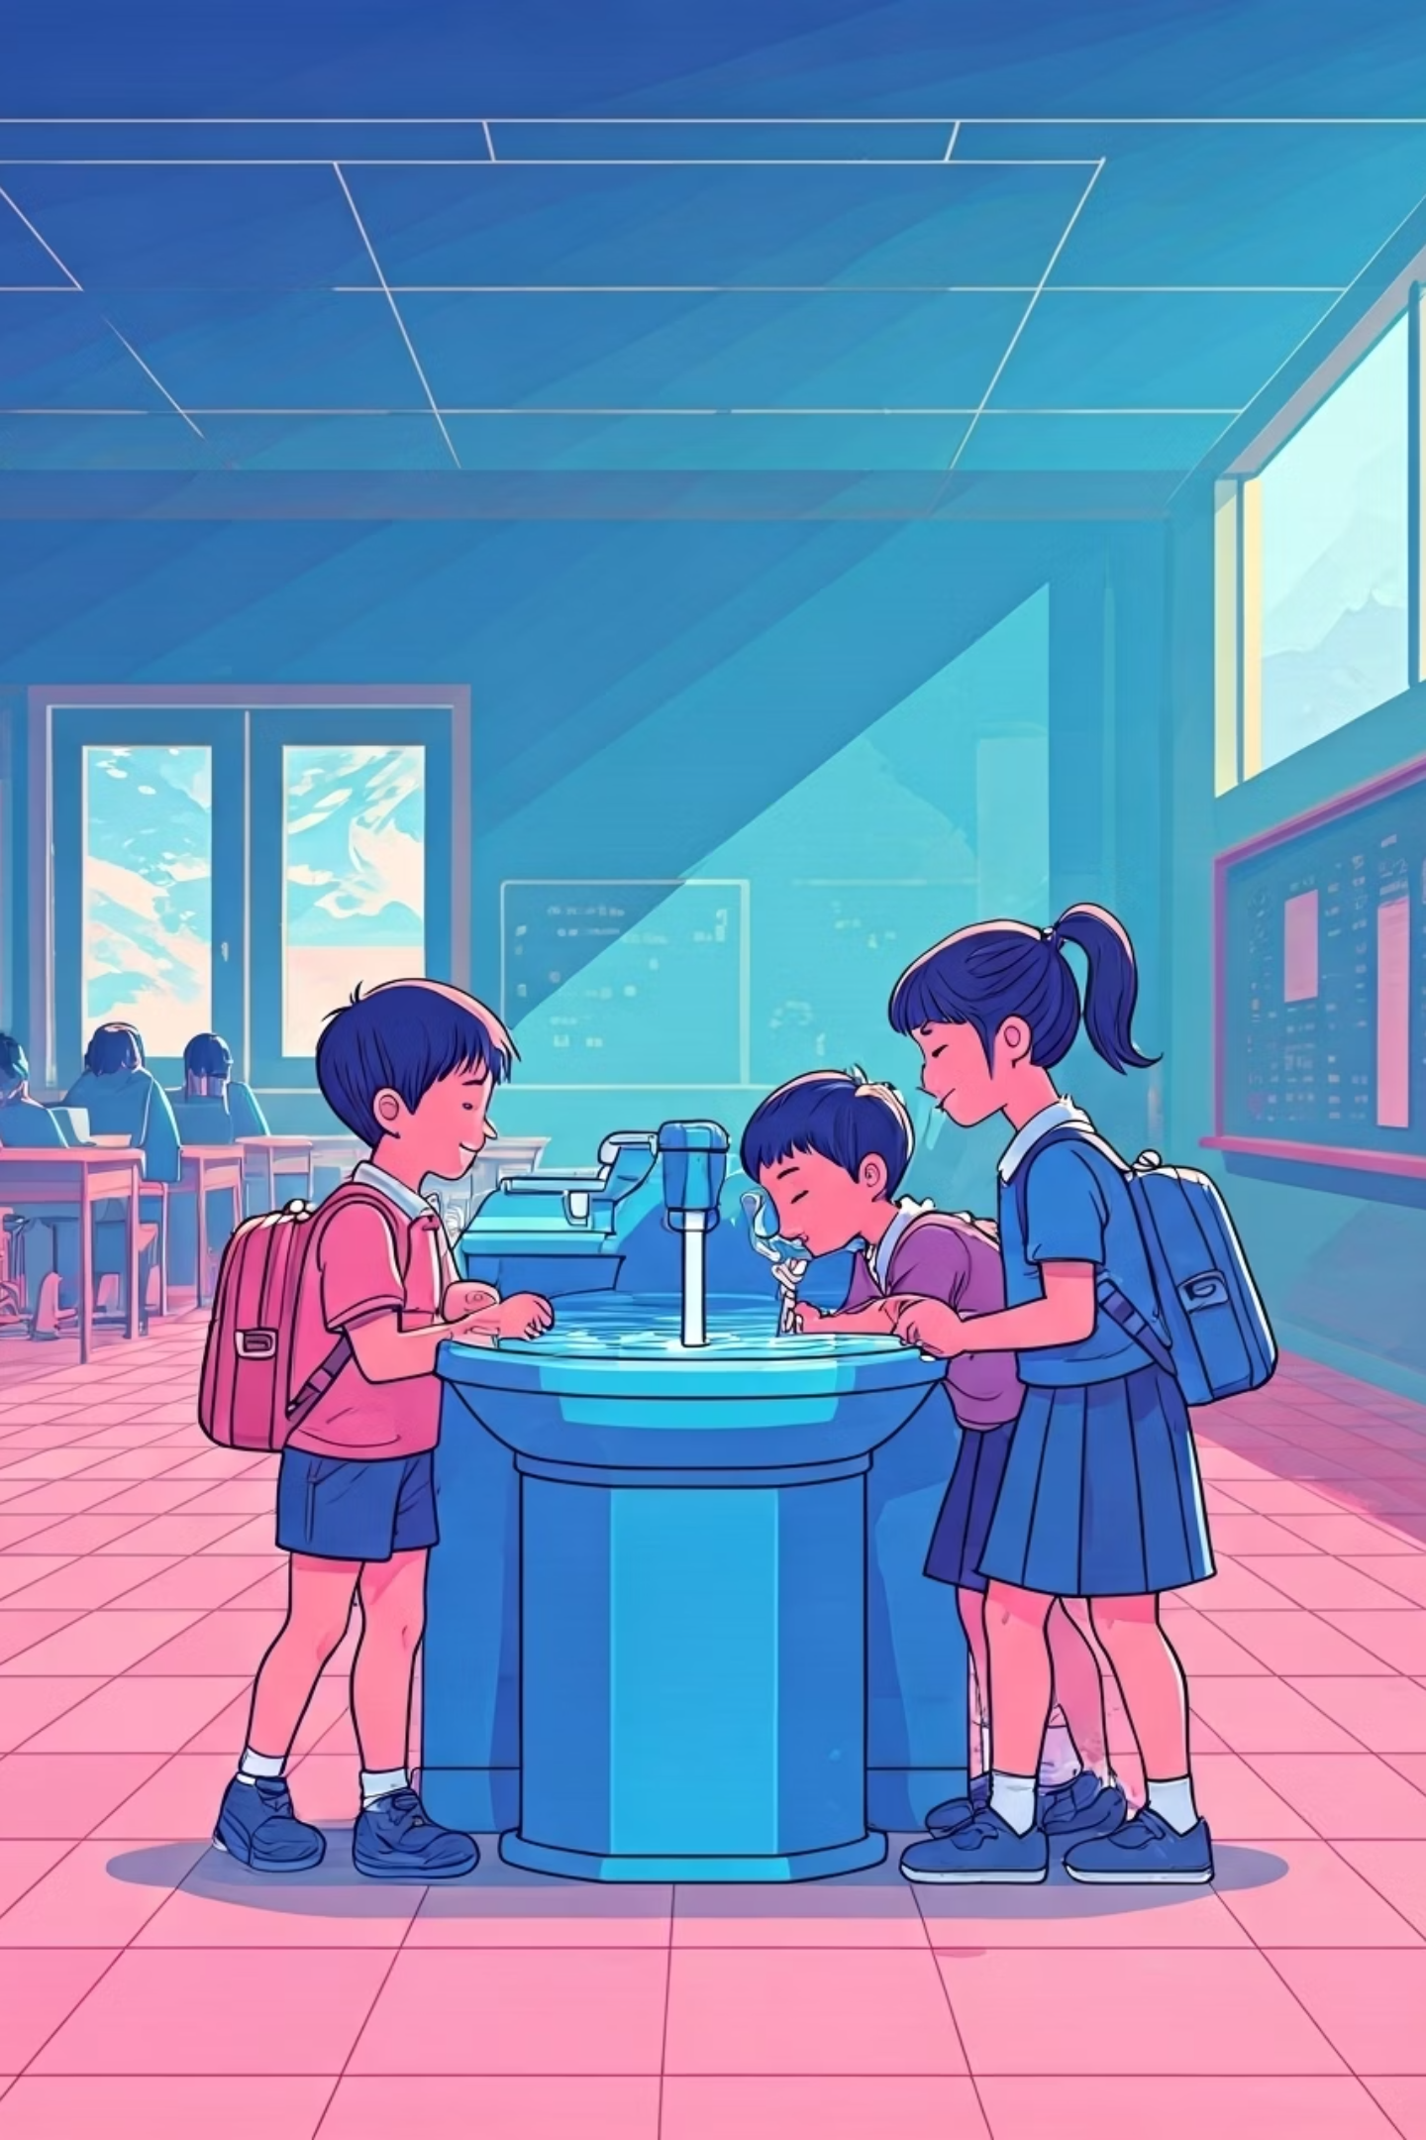
OUR MISSION
Water: A Foundation for Health & Learning
Clean water is fundamental for human health and effective learning environments. Yet, many students lack critical awareness regarding safe water storage and hygiene practices.
Our Community Service Project (CSP) tackled this vital issue, aiming to empower students with knowledge about safe drinking water and its importance.

Slide 4




PROJECT OBJECTIVES
Raise Awareness
Promote Habits
Bridge Knowledge
Educate on safe drinking water practices.
Encourage hygiene and water conservation.
Connect classroom learning to real-life water facilities.

Slide 5
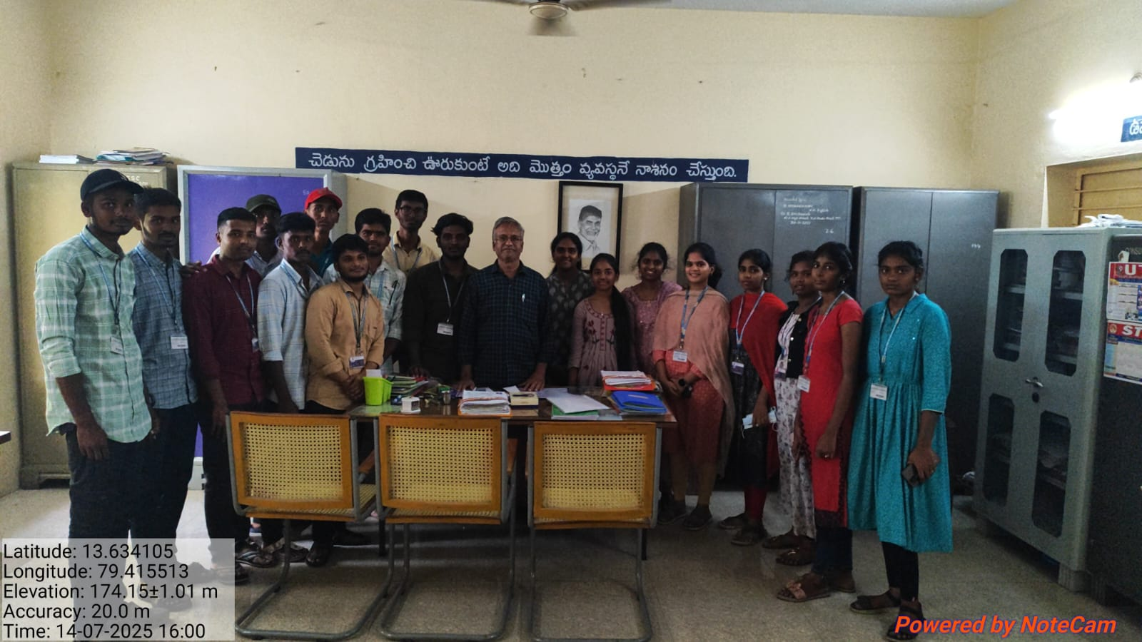
OUR SCHOOL VISIT
Our team embarked on a crucial visit to M.C.H.R.S. Mada Government School in Tirupati. This wasn't just a casual visit; it was a mission to understand and assess the current water situation.
Thoroughly inspected taps, water tanks, and surrounding areas.
Met with the Headmaster to discuss existing water infrastructure.
18 dedicated team members participated.

Slide 6
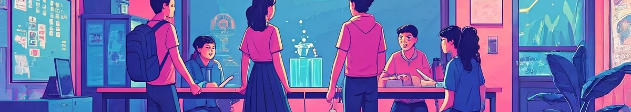



AWARENESS SESSIONS
To maximize impact, our team divided into smaller groups, each assigned to specific classes, ensuring focused and personalized interaction.
Grouped Approach
Targeted Classes
Key Topics Covered
Split into 3-4 member teams.
Visited students from 6th to 10th grade.
Defining safe water
Quality parameters
Purification methods
Safe storage
Hygiene practices

Slide 7
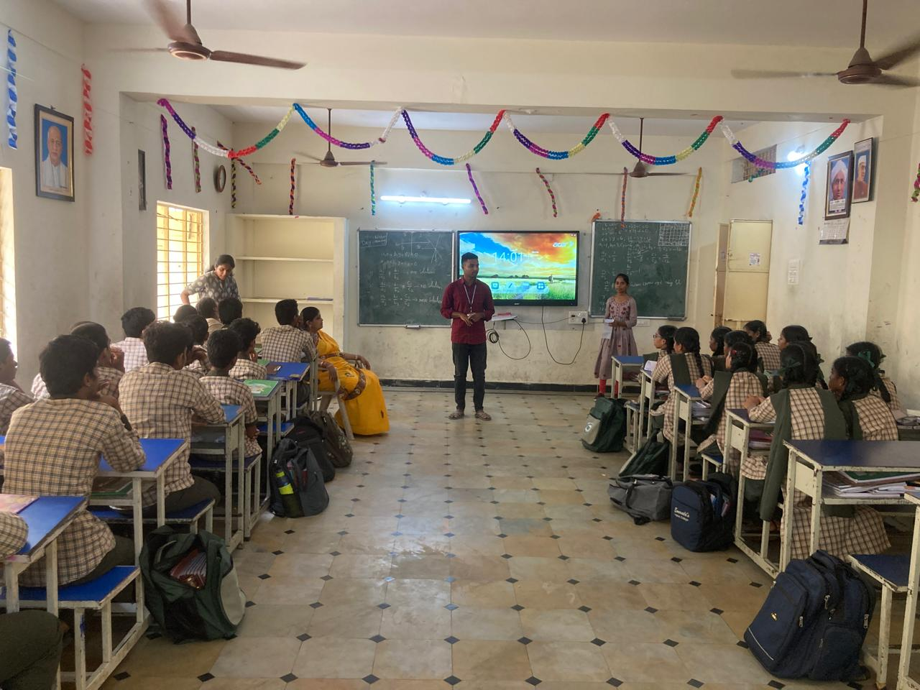
STUDENT INTERACTION
Our sessions were designed for active participation, fostering a dynamic two-way learning environment. Students were eager to share and learn:
Shared personal experiences with water at home and school.
Engaged with questions, clarifying doubts.
A truly interactive and enriching learning exchange.

Slide 8
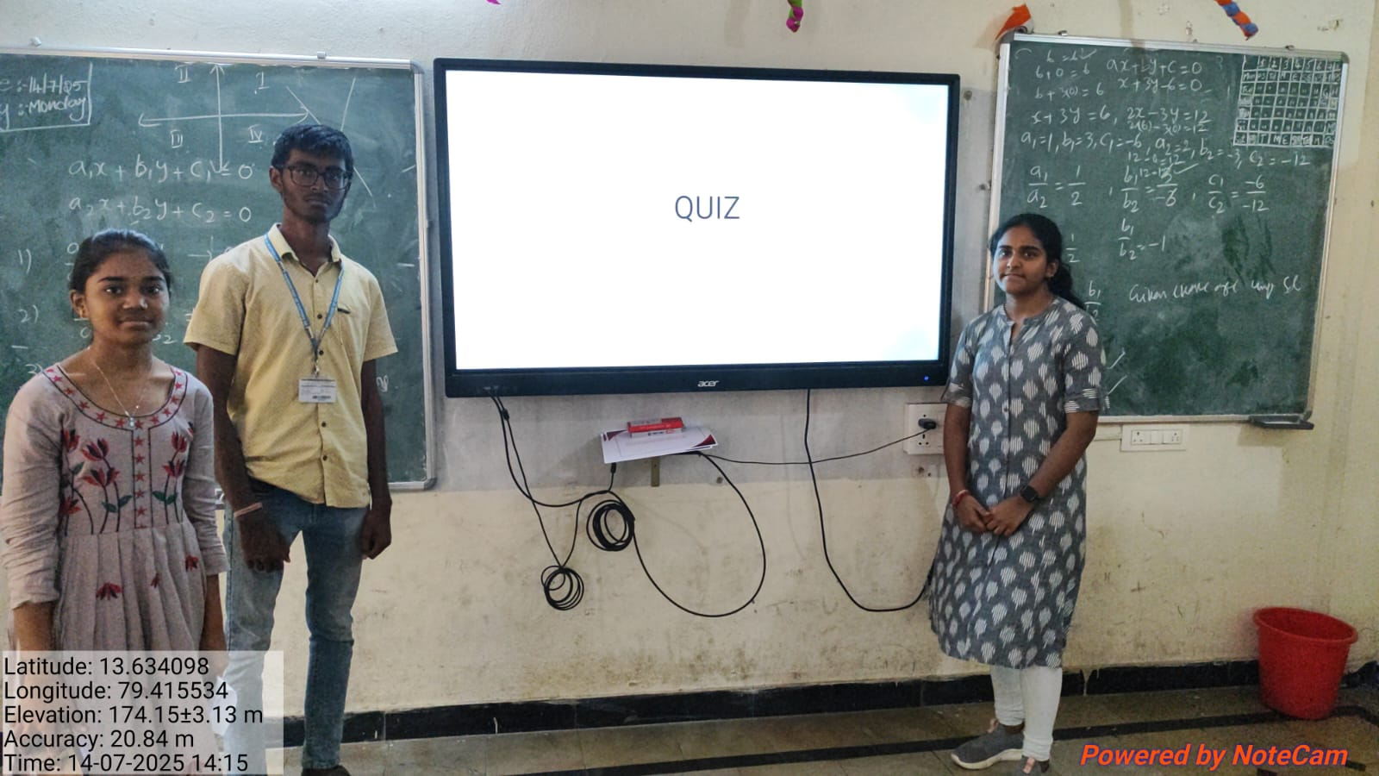
QUIZ COMPETITION
To reinforce learning and add an element of fun, we organized a quiz competition:
Individual quiz for Classes 6-10.
Questions on water safety, hygiene, and conservation.
Answers evaluated on the spot for immediate feedback.
Certificates & pens distributed to winners and runners.

Slide 9
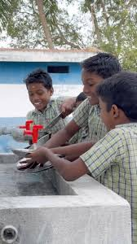
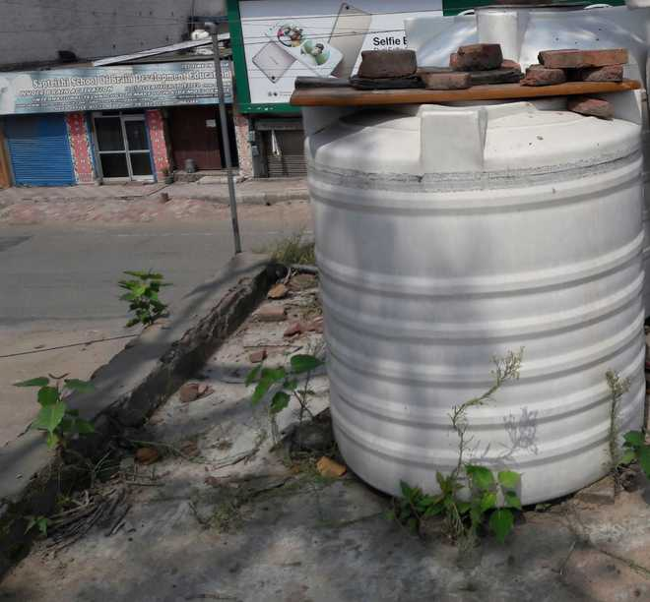
CHALLENGES & OPPORTUNITIES
Infrastructure Issues
Maintenance Gaps
Tanks need regular cleaning.
No routine water quality testing.
Some taps had leakage/loose handles.
Behavioral Aspects
Students sometimes waste water.
Awareness may fade without follow-ups.

Slide 10
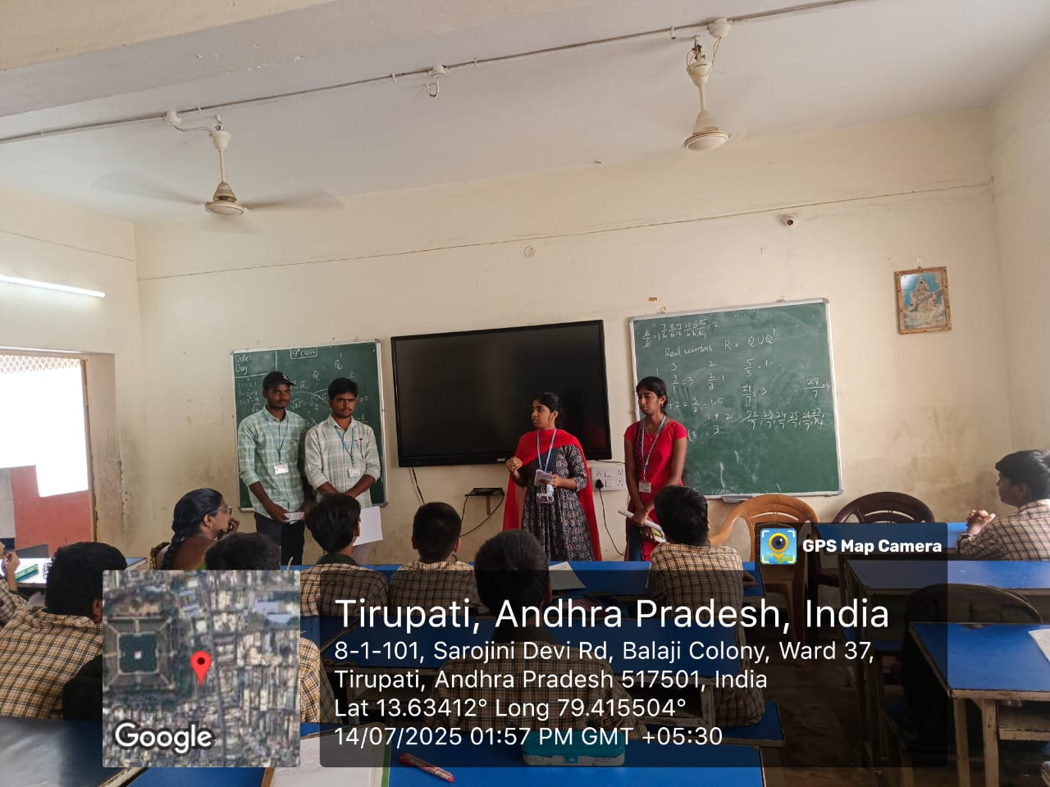
MEASURABLE OUTCOME
Student Impact
Gained practical awareness about water safety.
Teacher Feedback
Appreciated the interactive and engaging approach.
Engagement Boost
Increased student interest and participation.
Team Development
Improved teamwork and communication skills within our CSP group.

Slide 11
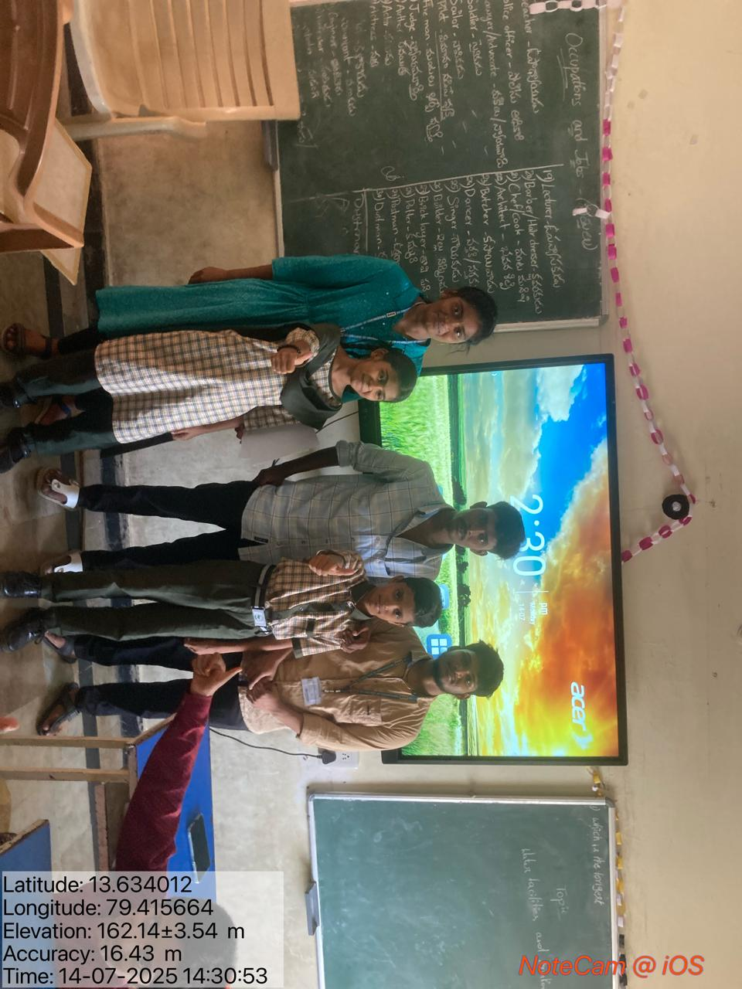
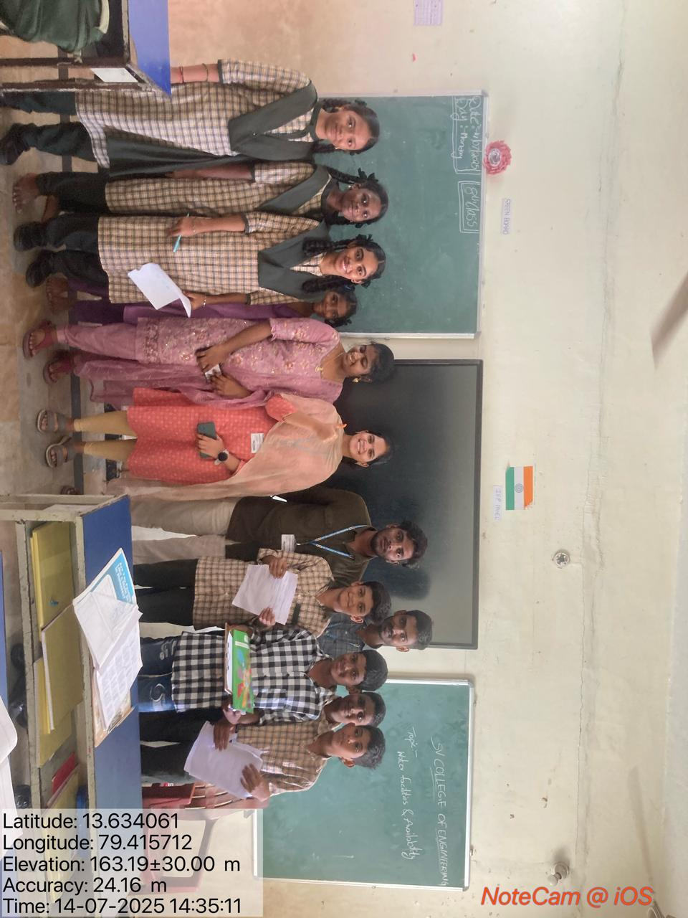
KEY TAKEAWAYS
Small Actions, Big Impact
This project reinforced that even small awareness drives can create significant, lasting positive change.
Students became more conscious of safe water practices.
Instilled a profound sense of social responsibility within our team.

Slide 12
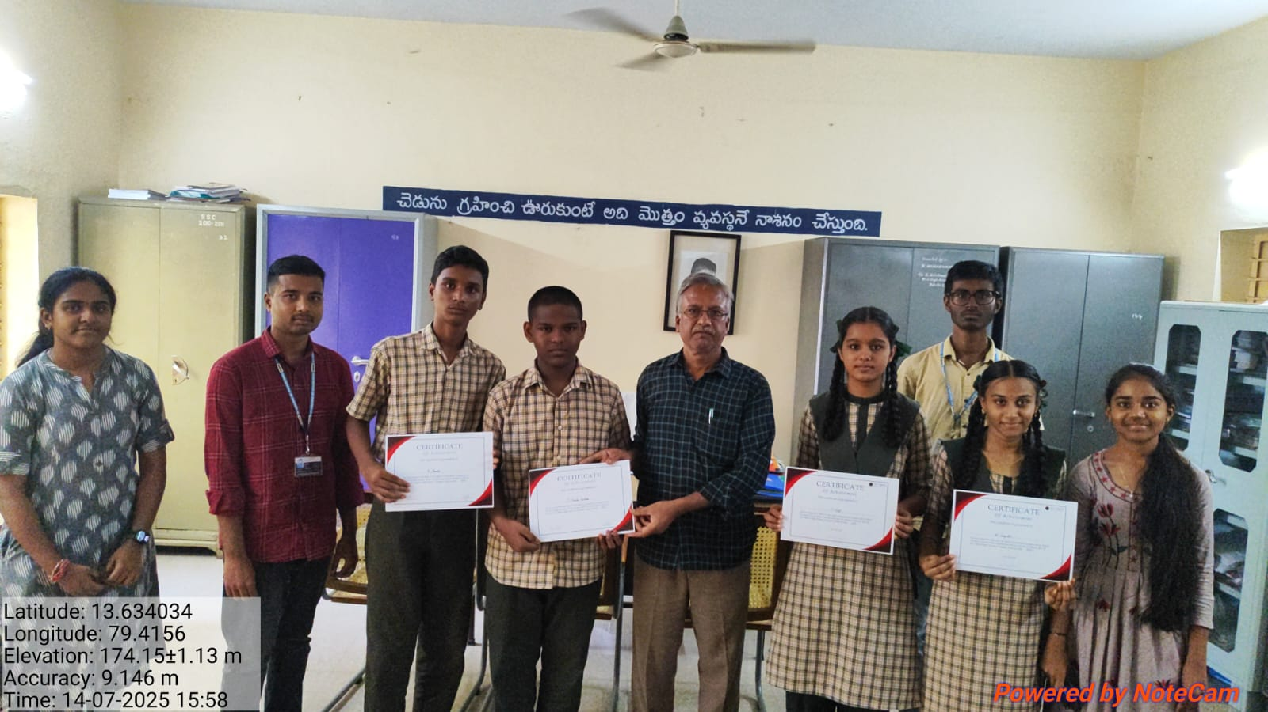
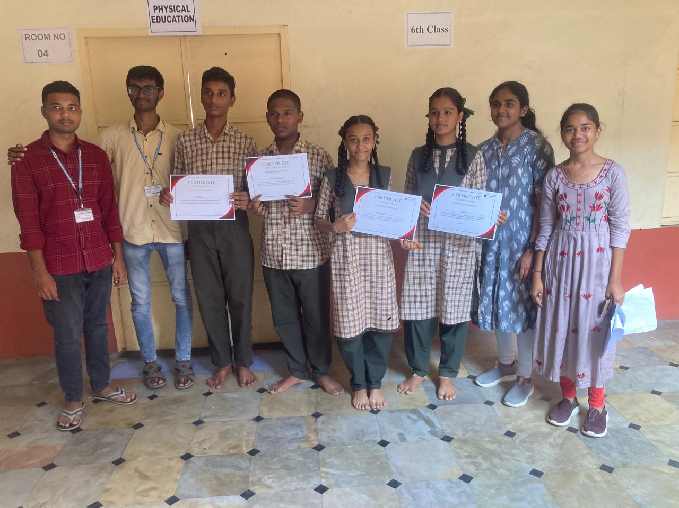
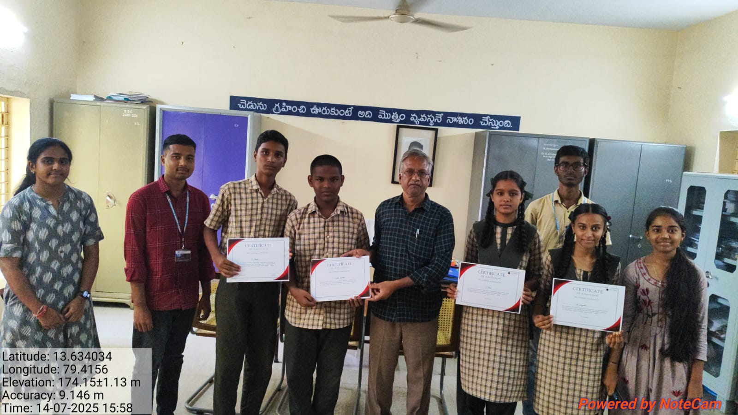
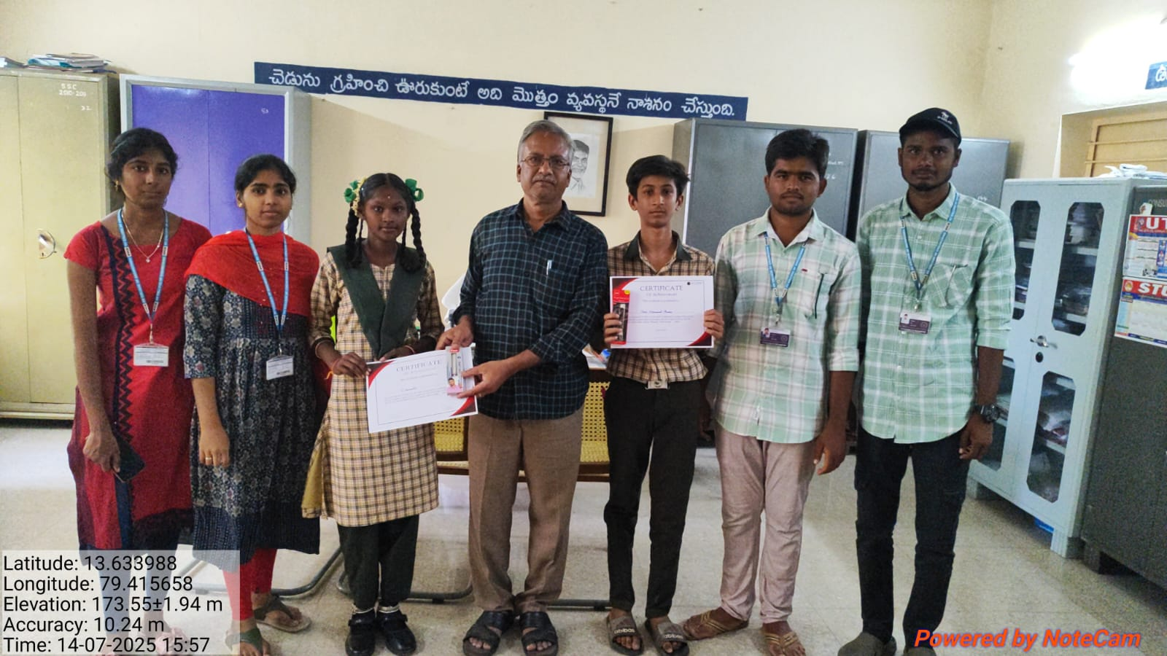
Picture Pane

Slide 13
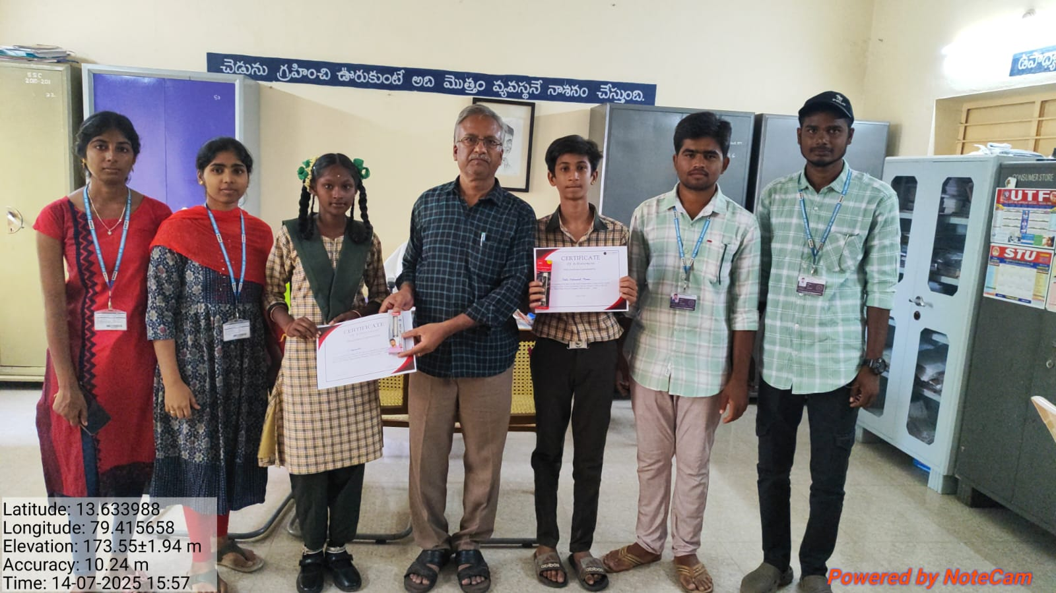
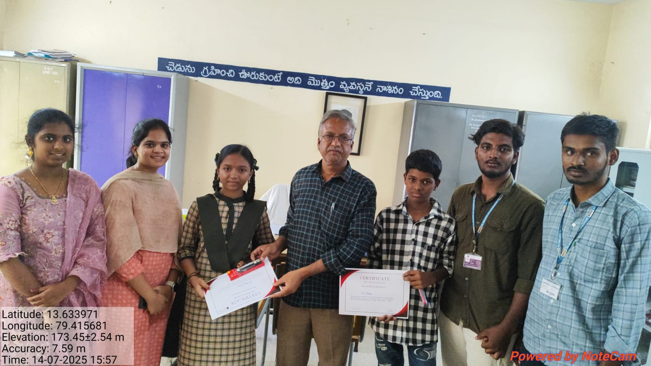
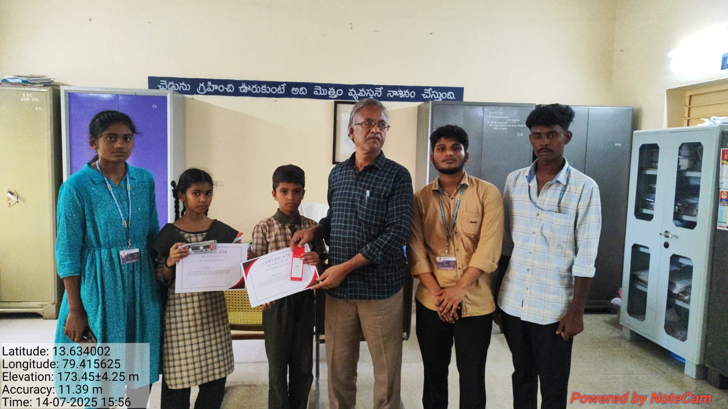
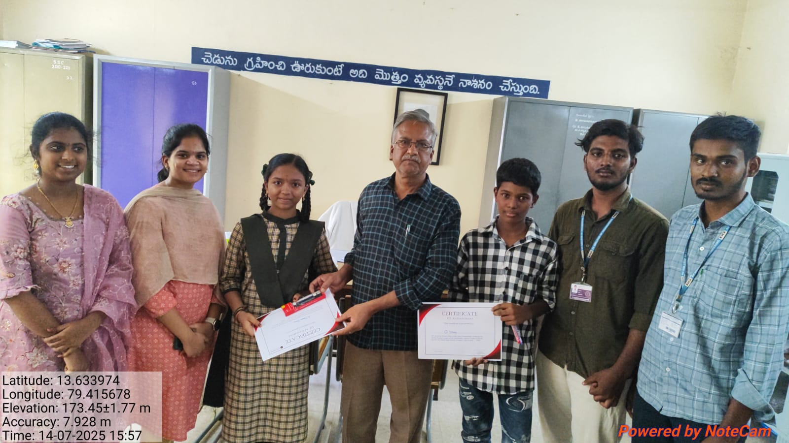

Slide 14
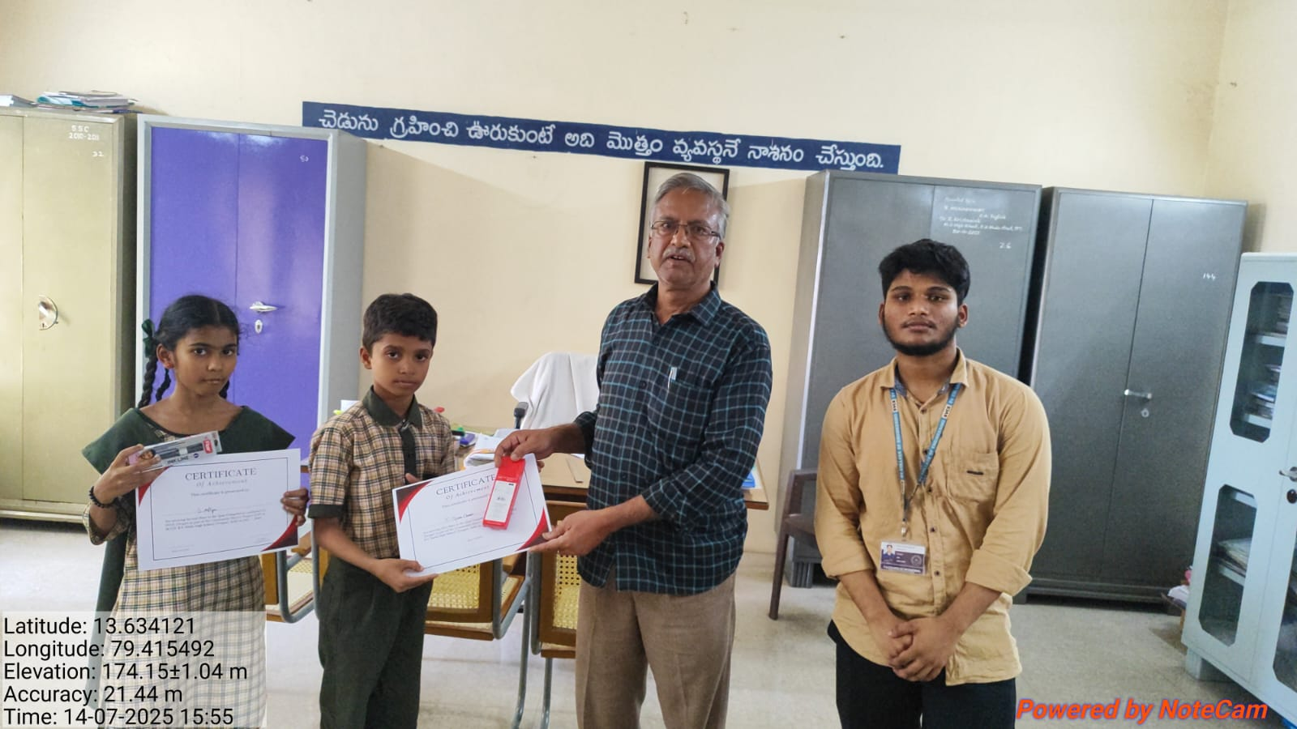
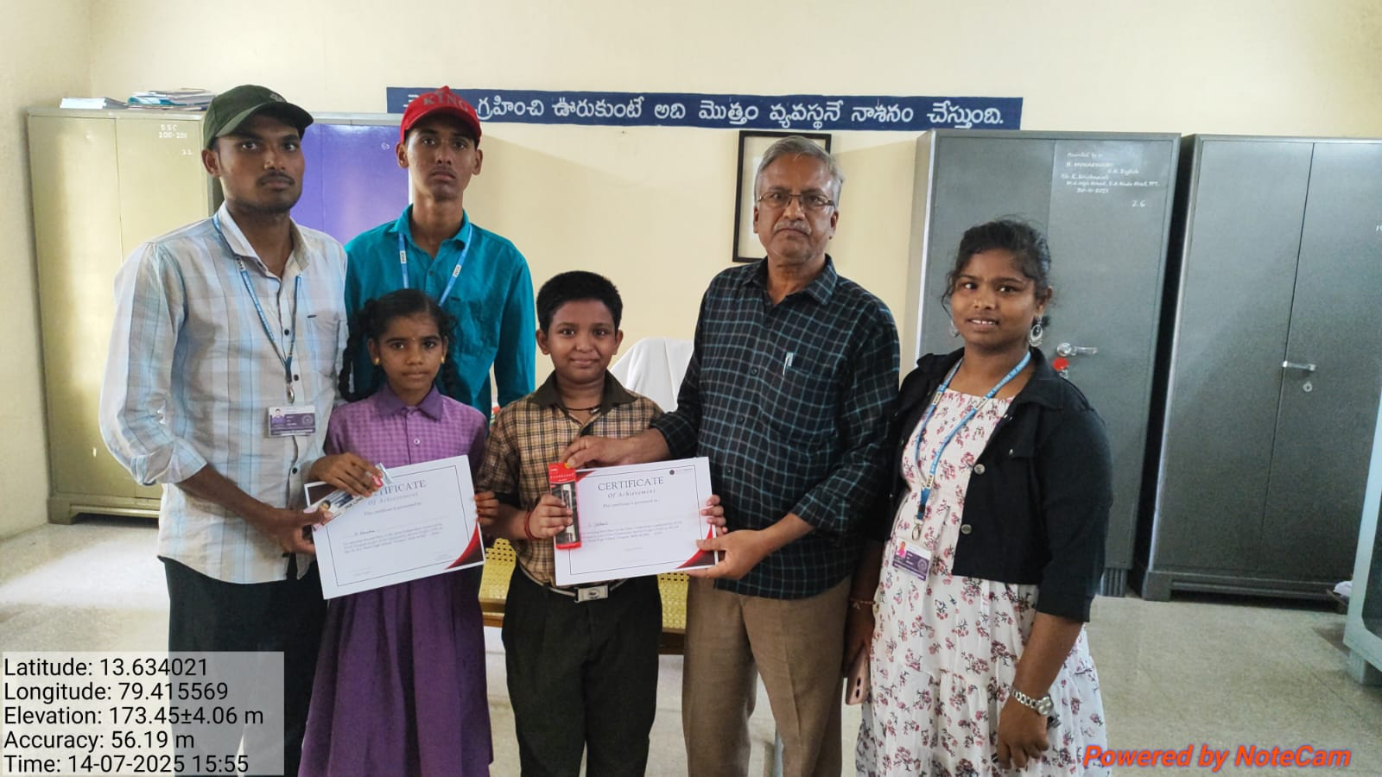
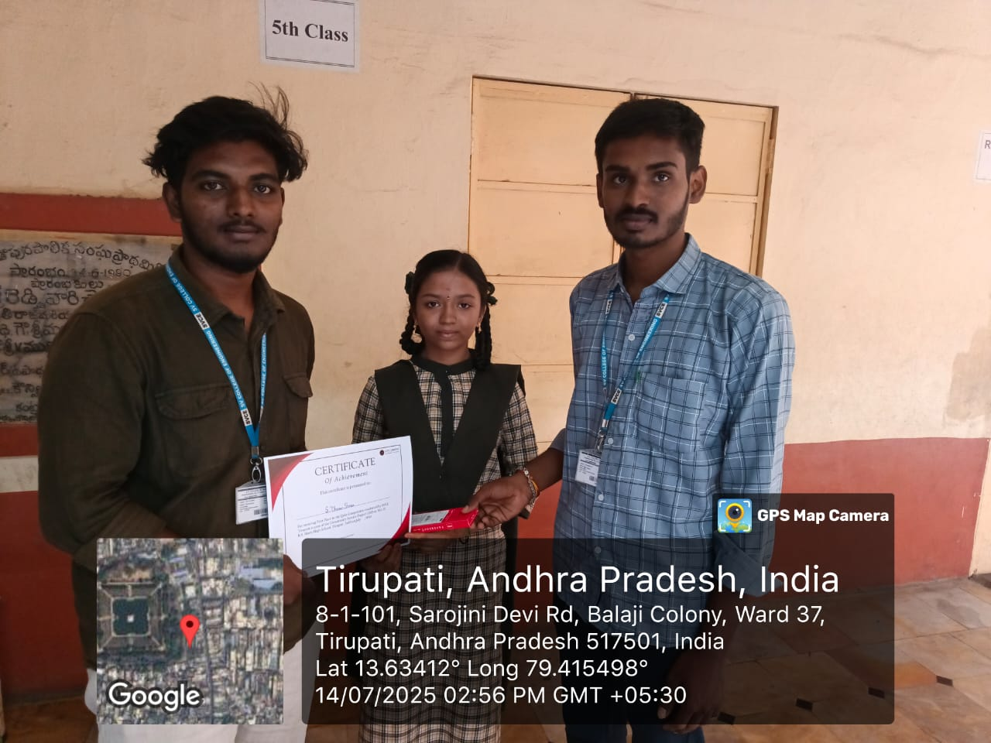

Slide 15
